Slide 1

TOMS RIVER SEAHAWKS FOOTBALL
INFORMATION PACKET

Slide 2

The Jersey Elite Conference is the philanthropic umbrella for the Toms River Seahawks, Brick Hydra and Lakewood Pioneers. All three teams participate in the new jersey shore pop warner conference. The JEC participates in fundraising and sponsorship opportunities to be able to reduce the cost of registration of all JEC athletes. The JEC is more than just football. The JEC promotes the STUDENT aspect of the student athlete. In the Toms River area, the JEC hosts weekly tutoring and assist with food insecurities. The JEC is part of backpack drives, coat distributions, Christmas present drives, and other community support programs. As the JEC expands within the Pop Warner family with Brick and Lakewood, they will be adding services to these communities.

Slide 3


NEW Jersey shore pop warner conference Bayshore lancers - Howell lions - Lakewood pioneers jersey shore storm (point Pleasant) - toms river angels brick hydra – lacey revolution - ocean dolphins saint james royals - toms river seahawks

Slide 4


Registration - SPRING 2026
SPRING FLAG - $95
Practices start march 18th
Washington street elementary school
games start Sunday April 5th
6 week schedule followed by tournament
no games mother’s day weekend
age based divisions

Slide 5
Registration – fall flag and tackle age group is determined based on your athlete’s age on July 14, 2026
Flag – ages 5, 6 and 7
8u – ages 6, 7 and 8
9u – ages 8 and 9
10 u – ages 9 and 10
11u – ages 10 and 11
12 u – ages 11 and 12
13 u – ages 12 and 13
14 u – ages 13 and 14

Slide 6
Registration – fall flag and tackle practices start august 1st west dover elementary school
FLAG AGES 5-6-7 $95
ALL TACKLE LEVELS AGES 8 AND OLDER $185
THIS DISCOUNTED RATE FOR ALL ATHLETES IS POSSIBLE THROUGH FUNDRAISING AND GENEROSITY OF THE JERSEY ELITE CONFERENCE
NO ATHLETE IS EVER TURNED AWAY FOR FINANCIAL REASONS
PAYMENT PLAN OPTIONS FOR TACKLE AVAILABLE STARTING IN JANUARY EACH YEAR
LIMITED NUMBER OF SCHOLARSHIP APPLICATIONS AVAILABLE EACH YEAR

Slide 7
TACKLE EQUIPMENT
NEW REGISTRANTS ARE PROVIDED
NEW HELMET WITH CHIN STRAP TO KEEP
NEW SHOULDER PADS TO KEEP
HOME AND AWAY GAME JERSEYS
GAME PANTS
RETURNING REGISTRANTS
RECONDITIONING OF YOUR HELMET AT A DEEP DISCOUNT
TRADE FOR EQUIPMENT THAT YOU HAVE OUT-GROWN
SUPPLIMENTAL UNIFORM NEEDS
PARENTS ARE RESPONSIBLE FOR THE FOLLOWING ITEMS
MOUTH GUARD THAT CONNECTS TO HELMET
CLEATS
PRACTICE PANTS AND JERSEY
COMPRESSION SHIRTS AND GIRDLE

Slide 8
FLAG EQUIPMENT
ALL REGISTRANTS ARE PROVIDED
FLAGS
HOME AND AWAY JERSEYS
SHORTS
PARENTS WILL NEED TO PROVIDE
MOUTH GUARDS
CLEATS

Slide 9
IMPORTANT DATES
MEDIA DAY – SUNDAY JUNE 7,2026
9 AM TO 12 PM
FRANK BARTOLF SPORTS COMPLEX 336 BROOK ROAD LAKEWOOD, NJ
MANDATORY PARENTS MEETING
COLLECTION OF PAPERWORK FOR BOOK CHECKS
HELMET FITTING
JERSEY NUMBER SELECTION
FREE BASELINE CONCUSSION TESTING
PICTURES – DJ – LASER TAG – SWAG - FOOD TRUCKS

Slide 10
IMPORTANT DATES – PRACTICE SCHEDULE
WEST DOVER ELEMENTARY SCHOOL 50 BLUE JAY DRIVE TOMS RIVER
SATURDAY AUGUST 1, 2026 – OPENING DAY 9 AM TO 11 AM
MONDAY AUGUST 3RD THROUGH FRIDAY AUGUST 7TH 6 PM TO 8 PM CONDITIONING - NO PADS, NO HELMETS
MONDAY AUGUST 10TH THROUGH THURSDAY SEPTEMBER 3RD
PRACTICE ON MON-TUES-WED-THURS 6 PM TO 8 PM
GAMES START SUNDAY SEPTEMBER 6TH
HOME GAMES ARE AT TOMS RIVER HIGH SCHOOL SOUTH 55 HYERS STREET TOMS RIVER
PRACTICE DECREASES WITH START OF SCHOOL AND GAMES
TUES-WED-THURS STARTING SEPTEMBER 8TH
COACHES FOR THE OLDER TEAMS MAY ADD FILM REVIEW AND WALK THROUGHS

Slide 11
IMPORTANT DATES
FAMILY DAY – SATURDAY AUGUST 15TH
ROB TAYLOR BASKETBALL COURTS - SOUTH TOMS RIVER
FREE BACKPACKS AND SCHOOL SUPPLIES – DJ – GAMES AND PRIZES
SPAGHETTI DINNER – TBD
DINING FOR DOLLARS NIGHTS
JERSEY MIKES - TBD
BURGER 25 - TBD
END OF THE YEAR BOWLING PARTY – JANUARY 2027
ANNUAL GIFT AUCTION AT SPICY’S IN SEASIDE HEIGHTS – FEBRUARY 2027

Slide 12

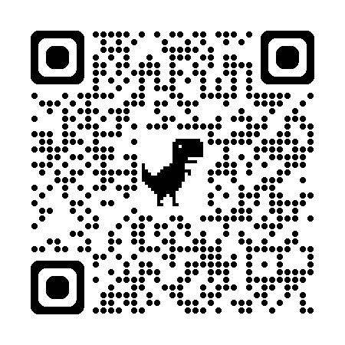
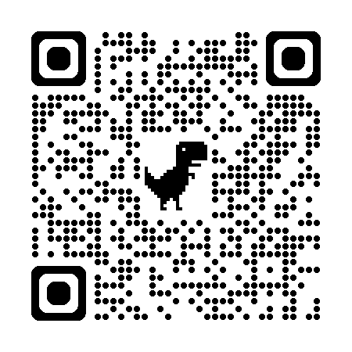
GAME SCHEDULES
WE DO NOT MAKE THE GAME SCHEDULES
GAMES ARE ON SUNDAYS AND START SEPTEMBER 6TH
WE WILL SHARE INFORMATION AS SOON AS WE GET IT
PLEASE JOIN YOUR TEAM APP
PLEASE FOLLOW US ON FACE BOOK AS TOMS RIVER SEAHAWKS
PLEASE FOLLOW US ON INTAGRAM AT TRSEAHAWKS
PLEASE BE PATIENT AND FLEXIBLE REGARDING THE SCHEDULE

Slide 13
HOW ARE WE DIFFERENT
NO BOND CHECKS
PLAYERS ARE PROVIDED THEIR OWN EQUIPMENT TO PROMOTE OWNERSHIP AND RESPONSIBILITY FOR THEIR ITEMS
NO VOLUNTEER HOURS REQUIRED
YOU ARE NOT GOING TO MISS YOUR ATHLETE PLAY TO BE IN A SNACK STAND
NO WAIVERS REQUIRED
DECREASED OVERALL COST
FUNDRAISING THROUGHOUT THE ENTIRE YEAR TO SUPPLIMENT EVERYONE’S REGISTRATION COSTS
ACADEMIC CENTRIC
MENTORSHIP AND TUTORING PROVIDED THROUGHOUT THE SCHOOL YEAR
POSITIVITY DRIVEN
WEEKLY FAMILY MEETINGS FOR ATHLETES AND PARENTS
FOCUSED ON IMPROVING FOOTBALL IQ
TRAINING IN SEASON WITH FORMER PROFESSIONAL FOOTBALL PLAYERS AND COLLEGIATE ATHLETES
GREAT RESOURCES IN THE NJSPW and JEC COMMUNITY
LOCAL HIGH SCHOOL COACHES INCLUDING SJV, RBC AND THE GARDEN STATE HERD
NO FRILLS
NO FORMAL BANQUET AT THE END OF THE YEAR – GOAL IS NOT FUND RAISING TO TRAVEL JUST BEFORE CHRISTMAS

Slide 14
FUNDRAISING
WE KNOW YOU ARE HIT UP AT SCHOOL, WORK, AND FOR EVERY OTHER ORGANIZATION YOUR FAMILY IS PART OF. RATHER THAN BUYING MUMS, COFFEE CAKES, RAFFLE TICKETS, WREATHS, POPCORN, COOKIES, ECT… WE DO ONE FUNDRAISER WITH A TOTAL REQUEST OF $50 PER FAMILY
OUR GIFT AUCTION IS OUR PRIMARY FUND RASING EVENT. IT IS HELD YEARLY IN FEBRUARY AT SPICY CANTINA IN SEASIDE HEIGHTS. WE ASK EACH FAMILY TO DONATE $50 TOWARDS THIS EVENT. THIS CAN BE AS CASH, A DONATED GIFT CARD OR BASKET FROM A LOCAL BUSINESS OR AS THE SUGGESTED PURCHASE BELOW. TEAM MOMS WILL COLLECT THE ITEMS THROUGHOUT THE SEASON. THIS WILL BE EXPLAINED IN DETAIL AT PARENT MEETINGS.
FLAG AND 8U – SCRATCH OFF TICKETS
9U AND 10 U – AMAZON GIFT CARDS
11U – PLAYSTATION/XBOX/NINTENDO/ROBLOX CARDS
12U – RESTAURANT GIFT CARDS
13 U AND 14 U – WINE OR SPIRITS

Slide 15
SPONSORSHIP
$100 DONATION
Your family name or business will be announced at half time of all home games
“Thank you” shared on our social media with your company logo and #s
Name/Logo will appear in our next gift auction brochure (every February)
$500 DONATION
Your business name/logo will appear on the back of 2026 TR Seahawks t-shirts
Your name/commercial announced a minimum 3 x during of all home games
“Thank you” blasted on social media 4 x during the season
Logo will appear in our next gift auction brochure (every February)
$1000 DONATION
Company banner hung at all home 2026 games (3 ft by 5 ft)
Banner hung at 2026 Media Day (June)
Banner hung at 2027 Winter Camp sessions (Feb-March)
business name/logo will appear on the back of 2026 TR Seahawks t-shirts
“Thank you” blasted on social media 6x x during the year
Logo and link to your webpage/social media on team registration page
Announced a minimum of 5 x during of all home games
Logo will appear in our next gift auction brochure (every February)
HALF TIME SPONSORS $1500
Themed race at all half time of all home games
(think about Pork roll/Egg/Cheese at the Blue Claws)
Everything noted in the $1000 Donation
KICK OFF PACKAGE - $2500 DONATION
Company sponsorship of Break-Thru banner for home and away games
will be used at all levels- up to 8 games a weekend
4 tickets to our next gift auction
Everything noted in the $1000 donation
END ZONE PACKAGE - $2500 DONATION
Red Carpet Backdrop/Photo Backdrop with company logo set up in Family area at all home games
Mascot Pictures
Social Media photo contests with #your business for home games
4 tickets to our next gift auction
Everything noted in the $1000 donation

Slide 16
COACHES and TEAM MOMS
If you are interested in volunteering as a coach please email
mike@jec.football
If you are interested in being a team mom/dad please email
heather@jec.football
We limit all coaching staffs to 4 coaches and 2 team parents
In addition to the online required trainings and background checks
Coaches will need to attend coaches symposium on Saturday June 13th
Team moms will have meeting before media day on Sunday June 7th so you are prepared to collect paperwork for book checks

Slide 17

2026 WINTER WORK OUTS
Off season training at Adrenaline sports academy in toms river
Work on speed, agility, and positional training
Colligate athletes, professional athletes and college coaching staffs will all join our tr seahawk coaches to help build your athlete’s sports iq
$5 a session for all registered 2026 Seahawks
$10 for all others

Slide 18



CAMPS
Follow our social media to
learn more about local camps
FB Toms river seahawks – Insta TRSeahawks
2026 BIG MAN TOURNAMENT
FIRST TIME HITTERS ROOKIE CAMP
FRIDAY NIGHT LIGHTS

Slide 19


swag
Link for swag will be added when the store is open
Will also share on all socials and on registration page

Slide 20
CONTACT INFO
SUPPORT@TRSEAHAWKS.COM
HEATHER@JEC.FOOTBALL
MIKE@JEC.FOOTBALL
848-223-3801

